Slide 1
Visual Analytics for AMI
Microgrids and other supporting work
Prof. Chris Foreman
School of Engineering Technology
jchrisf@purdue.edu

Slide 2
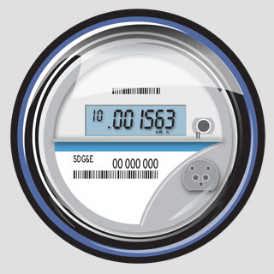
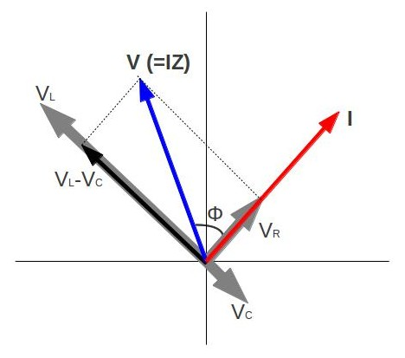
Visual Analytics for AMI
.
.
.
Smart meters
.
Millions of points of measurement
Dense spatial and temporal data
Need visual analytic tools as conventional
analyses are too inefficient
.
.
…
…
Not just metrology but significant network traffic
Cyber-security, anomaly/intrusion detection
.
.
.
…
Visualization supports knowledge discovery
Intelligent, parallel monitoring algorithms
Decision making through expert system engine
sPMU
sPMU
30 smart meter microgrid currently under developed at Purdue

Slide 3
Visual Analytics for AMI
Voltage
Power
factor
Energy
usage
Network
statistics
Other
data
Use image processing and pattern recognition techniques for aggregate analysis of multiple data layers
Parallel processing such as artificial neural networks, software agents
Visual analytics is optimal since humans have a natural strength in visual processing

Slide 4
Microgrid Labs
New lab under development with 30 smart meters for simulation of microgrid information networks
  Cyber-security on microgrids, network architectures
  Application development, load management
  Data analysis and collection techniques
Other labs include
  Power electronics labs for motor drives, inverters, solid state transformers
  Rotating machines development lab
  PEV lab for research in incorporating EVs
  Rooftop solar power microgrid on campus integrated to building energy system HVAC
  Shipboard scale DC microgrid
  DoD ESTCP Microgrid Project

